Slide 1
What does a physicist look like? What do they do?

Slide 2
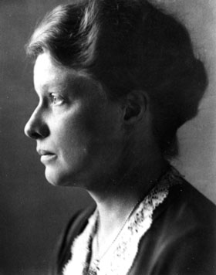
Hertha Sponer
Molecular physics
By Source (WP:NFCC#4), Fair use, https://en.wikipedia.org/w/index.php?curid=57442290

Slide 3
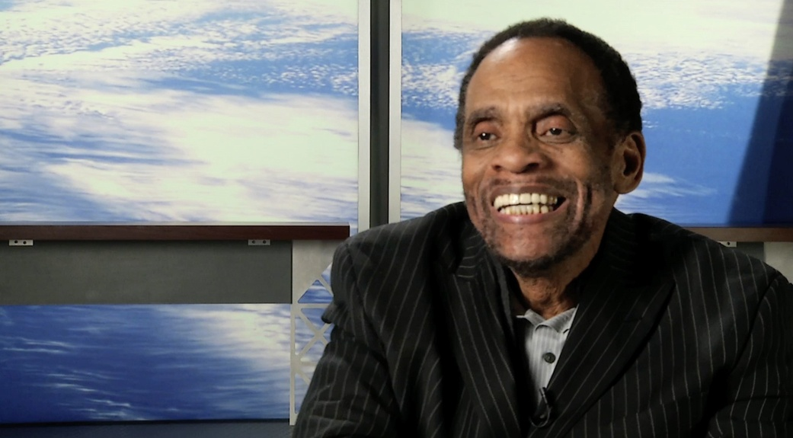
George Edward Alcorn Jr.
Rocket Scientist
Inventor
By NASA's Goddard Space Flight Center - https://www.nasa.gov/sites/default/files/thumbnails/image/george-alcorn.jpg, Public Domain, https://commons.wikimedia.org/w/index.php?curid=56950545

Slide 4
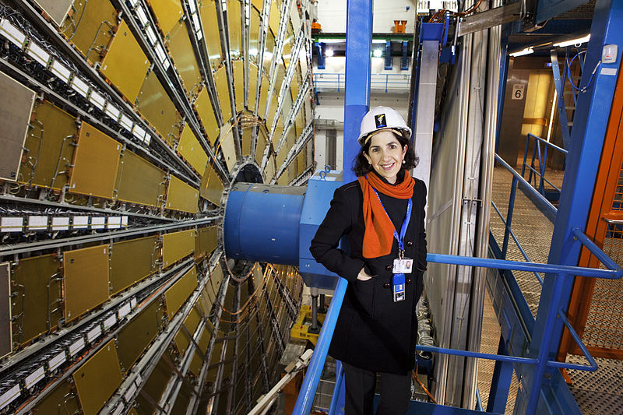
Fabiola Gianotti
Particle Physics
By ATLAS Experiment © 2011 CERN, CC BY-SA 4.0, https://commons.wikimedia.org/w/index.php?curid=38896344
https://www.youtube.com/watch?time_continue=17&v=Xtt-6kH2aSI

Slide 5
Dorothy Hodgkins
X-ray spectroscopy of insulin etc.
By NASA's Goddard Space Flight Center - https://www.nasa.gov/sites/default/files/thumbnails/image/george-alcorn.jpg, Public Domain, https://commons.wikimedia.org/w/index.php?curid=56950545
https://www.youtube.com/watch?v=yF9ejcyzdfY

Slide 6
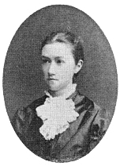
Agnes Pockels
Surface tension
By Unknown - http://www.physics.ucla.edu/~cwp/Phase2/Pockels,_Agnes@871234567.html 2013-07-13 01:01:18, Public Domain, https://commons.wikimedia.org/w/index.php?curid=27223603
https://www.youtube.com/watch?v=jPsgzfKb5Fc

Slide 7
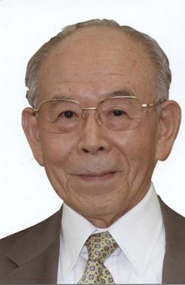
Isamu Akasaki
Semiconductor technology
This work is licensed under the Government of Japan Standard Terms of Use (Ver.2.0). The Terms of Use are compatible with the Creative Commons Attribution License 4.0 International.

Slide 8
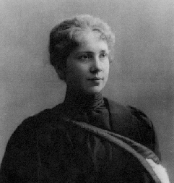
Harriet Brooks
Radioactivity
By The original uploader was QueenAdelaide at English Wikipedia. - Transferred from en.wikipedia to Commons by Armando-Martin using CommonsHelper., Public Domain, https://commons.wikimedia.org/w/index.php?curid=15692007.
https://www.youtube.com/watch?time_continue=15&v=zFhGguLPisk

Slide 9
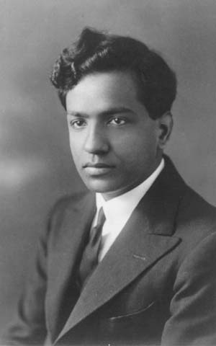
Subrahmanyan Chandrasekhar
Stellar evolution
Chandra X-Ray Observatory, NASA
https://www.youtube.com/watch?v=Tqi2CYsaqBM

Slide 10
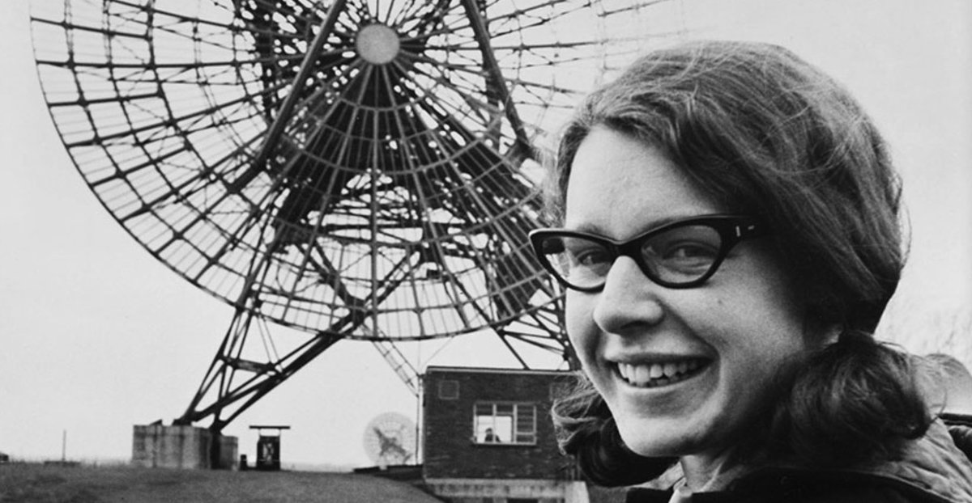
Jocelyn Bell Burnett
pulsars
Video: https://www.youtube.com/watch?time_continue=68&v=PKtnaTxLARc

Slide 11
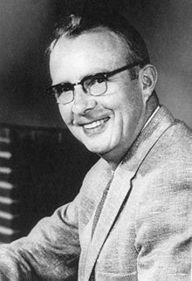
Luis Walter Alvarez
Nuclear physics
By Unknown - [1] Dutch National Archives, The Hague, Fotocollectie Algemeen Nederlands Persbureau (ANEFO), 1945-1989, Public Domain, https://commons.wikimedia.org/w/index.php?curid=20428593
https://www.youtube.com/watch?v=ct7Kk0nhOWs

Slide 12
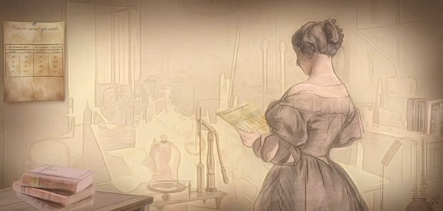
Eunice Foote
Climate Change
Drawing by Carlyn Iverson, NOAA Climate.gov.
https://www.youtube.com/watch?time_continue=1&v=XpqBto89i38

Slide 13
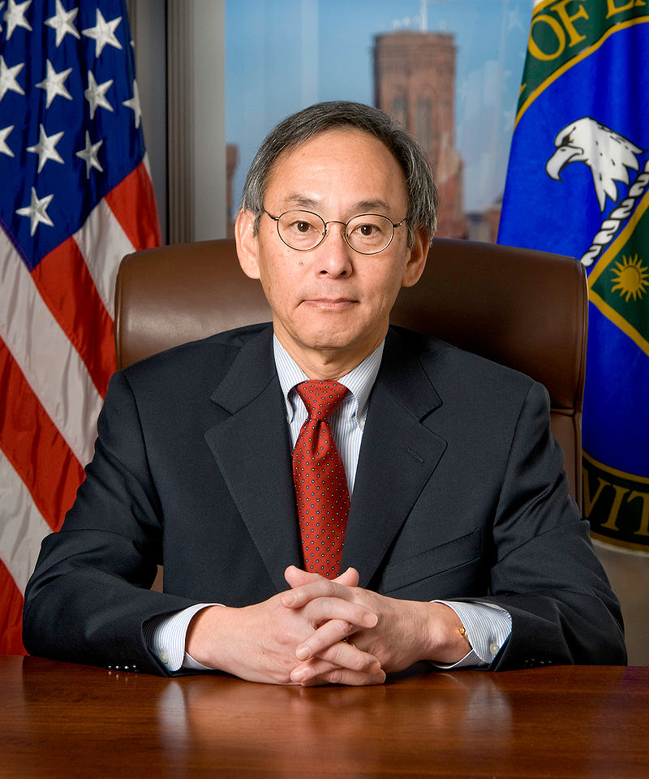
Steven Chu
Cooling atoms with lasers, Climate Change
By Department of Energy - Obtained via email from Department of Energy., Public Domain, https://commons.wikimedia.org/w/index.php?curid=7357951
https://www.youtube.com/watch?v=sbKEYjXX8NY

Slide 14
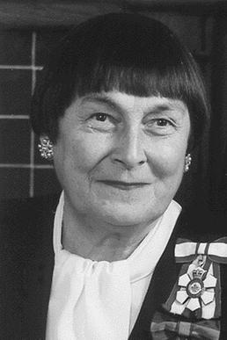
Sylvia Fedoruk
cobalt-60 cancer treatment
By Source, Fair use, https://en.wikipedia.org/w/index.php?curid=4676743
https://fedorukcentre.ca/resources/videos.php

Slide 15
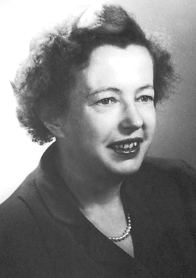
Maria Goeppert Mayer
Nuclear Shell model
By Nobel foundation - http://nobelprize.org/nobel_prizes/physics/laureates/1963/mayer-autobio.html, Public Domain, https://commons.wikimedia.org/w/index.php?curid=6140956
https://www.youtube.com/watch?v=lSIa3dgAWAE

Slide 16
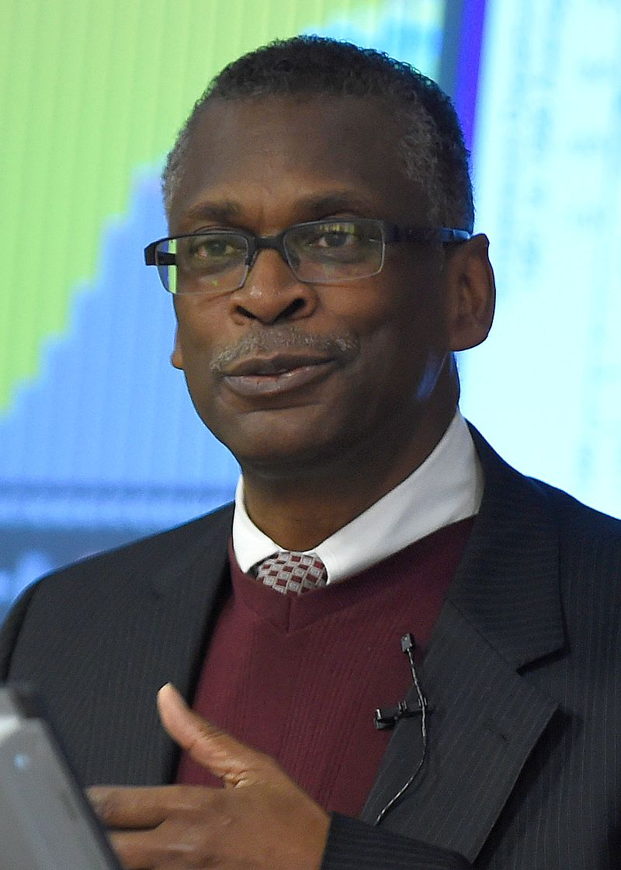
Lonnie George Johnson
Supersoaker inventor, rocket scientist
By Office of Naval Research - https://www.flickr.com/photos/usnavyresearch/24149474954/, Public Domain, https://commons.wikimedia.org/w/index.php?curid=52712374
https://www.youtube.com/watch?v=SYq6aKLuSk0

Slide 17
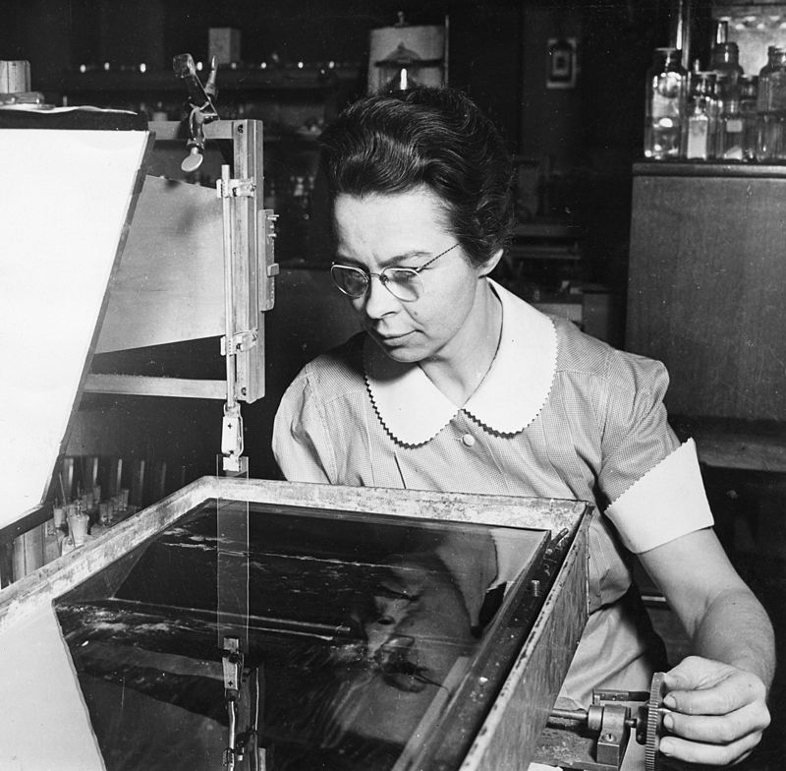
Katherine Burr Blodgett
Invisible glass
By Smithsonian Institution from United States - Katharine Burr Blodgett (1898-1979), demonstrating equipment in lab, No restrictions, https://commons.wikimedia.org/w/index.php?curid=7409636
Video: https://video.kqed.org/video/katharine-burr-blodgett-she-inspires-marl6o/

Slide 18
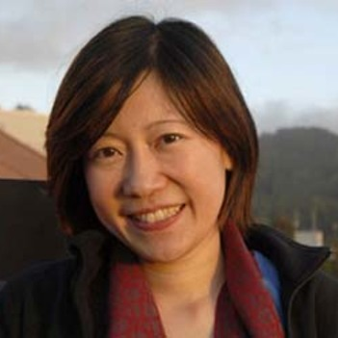
Ching-Pei Ma
Large black holes
https://www.youtube.com/watch?v=-EmgXM2OvOI

Slide 19
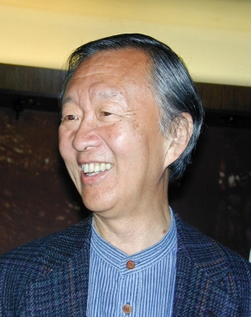
Charles K Kao
Fibre optics
Video: www.youtube.com/watch?v=2-5sScP_fiw

Slide 20
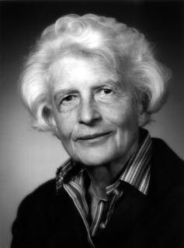
Gertrude Scharff Goldhaber
Beta particles
By Source, Fair use, https://en.wikipedia.org/w/index.php?curid=24675947

Slide 21
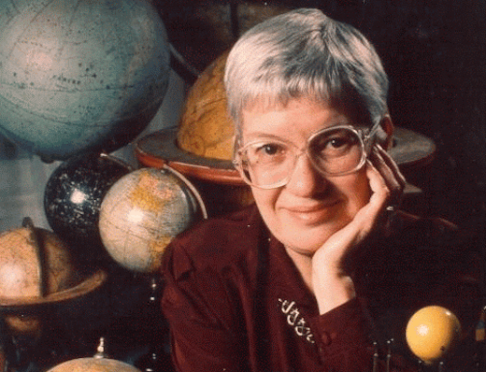
Vera Rubin
Dark matter
Video: https://www.perimeterinstitute.ca/outreach/teachers/class-kits/mystery-dark-matter

Slide 22
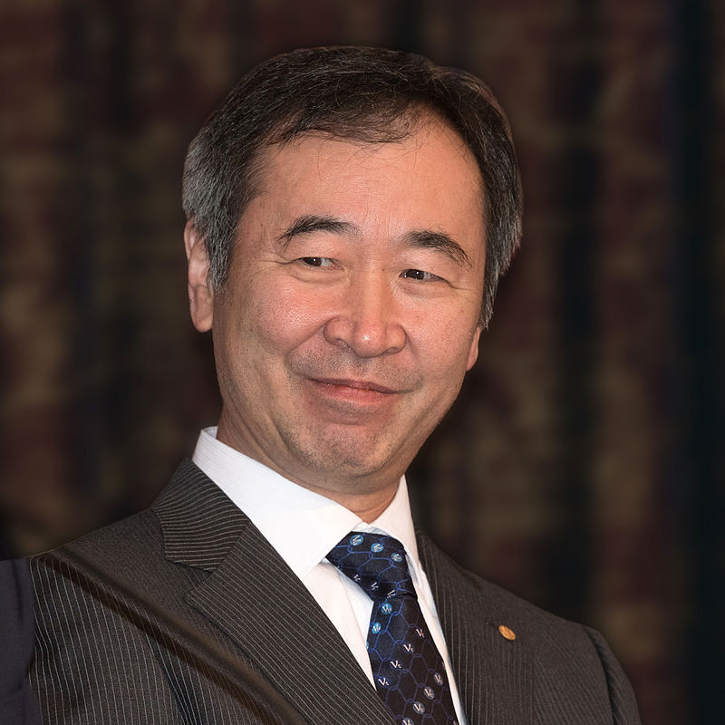
Kajita Takaaki
neutrinos
By Bengt Nyman - Own work, CC BY-SA 4.0, https://commons.wikimedia.org/w/index.php?curid=45491583
https://www.youtube.com/watch?v=577vRhjCluE

Slide 23
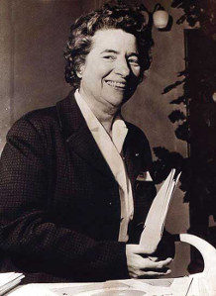
Marguerite Perey
Discovered Francium
By Source, Fair use, https://en.wikipedia.org/w/index.php?curid=38939348
https://www.youtube.com/watch?v=Ab-PudCprYE

Slide 24
Donna Strickland
Laser
Video: https://youtu.be/XjXLJMUrNBo

Slide 25
Powtawche Valerino
Navigation engineer Cassini Mission
By Jesswade88 - Own work, CC BY-SA 4.0, https://commons.wikimedia.org/w/index.php?curid=69325717

Slide 26
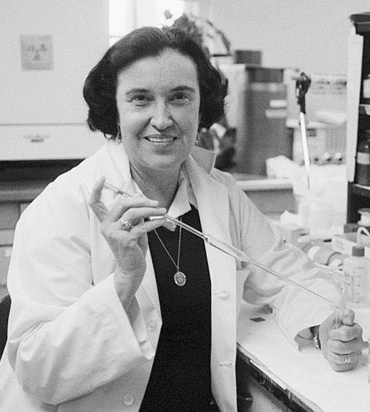
Rosalyn Yalow
Radioimmunoassay
By US Information Agency (see image credits at the end) - Women of Influence, pg. 28, Public Domain, https://commons.wikimedia.org/w/index.php?curid=15391747
https://www.youtube.com/watch?v=giYE7CxmDbA

Slide 27
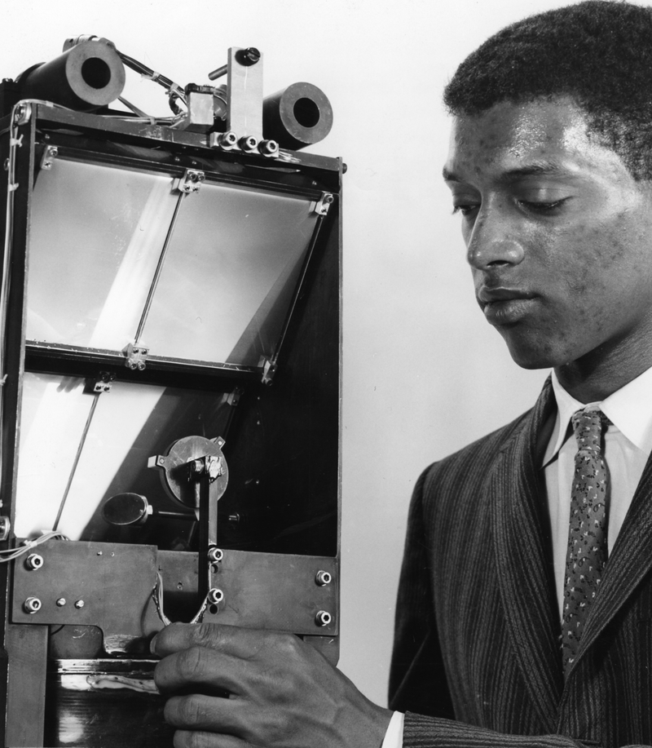
George Robert Carruthers
Inventor of the Far UV electrographic camera
Video: https://www.youtube.com/watch?v=d2eNwNNHMIk

Slide 28
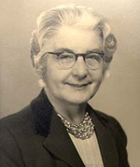
Bertha Swirles Jeffreys
Quantum theory
By Source, Fair use, https://en.wikipedia.org/w/index.php?curid=10451323

Slide 29
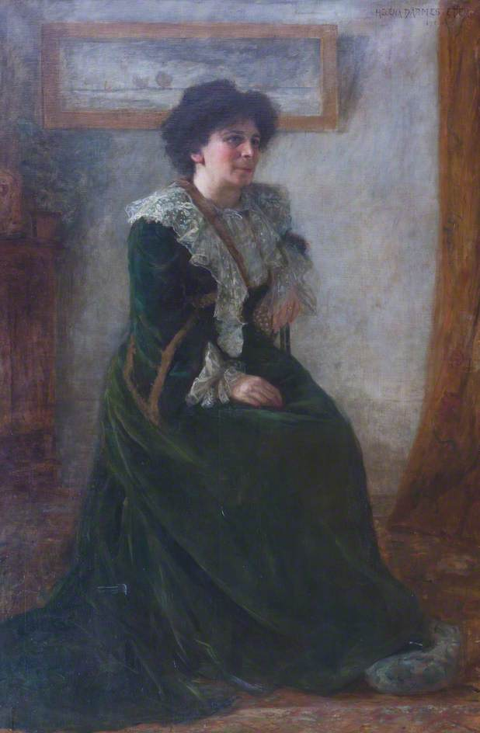
Hertha Ayrton
Arc Lighting
By Héléna Arsène Darmesteter - Art UK, Public Domain, https://commons.wikimedia.org/w/index.php?curid=38762387
https://twitter.com/bbcideas/status/1049671325273460738

Slide 30
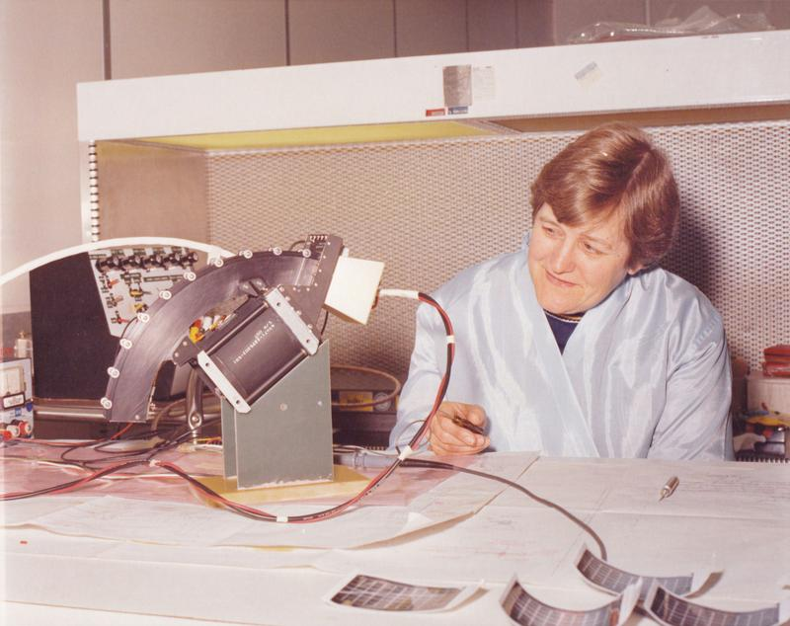
Yvonne Brill
Rocket Propulsion
https://www.youtube.com/watch?v=6LP2Ni0c1Bg

Slide 31
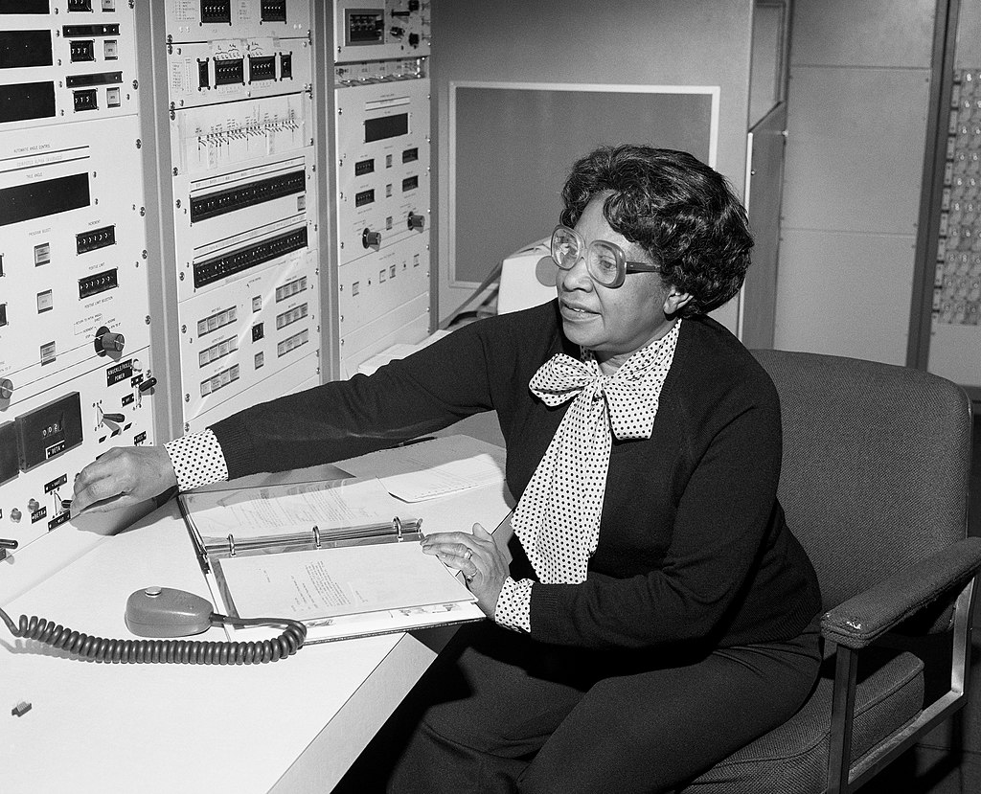
By NASA Langley Research Center; restored by Adam Cuerden - https://www.nasa.gov/image-feature/mary-jackson-at-nasa-langley-1, Public Domain, https://commons.wikimedia.org/w/index.php?curid=78357568
Mary Jackson
Aerospace Engineer
https://www.youtube.com/watch?v=HwUrrNbc8Zs

Slide 32
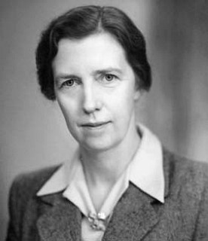
Mary Cartwright
Radar, chaos theory
By Anitha Maria S - Own work, CC BY-SA 4.0, https://commons.wikimedia.org/w/index.php?curid=45122303

Slide 33
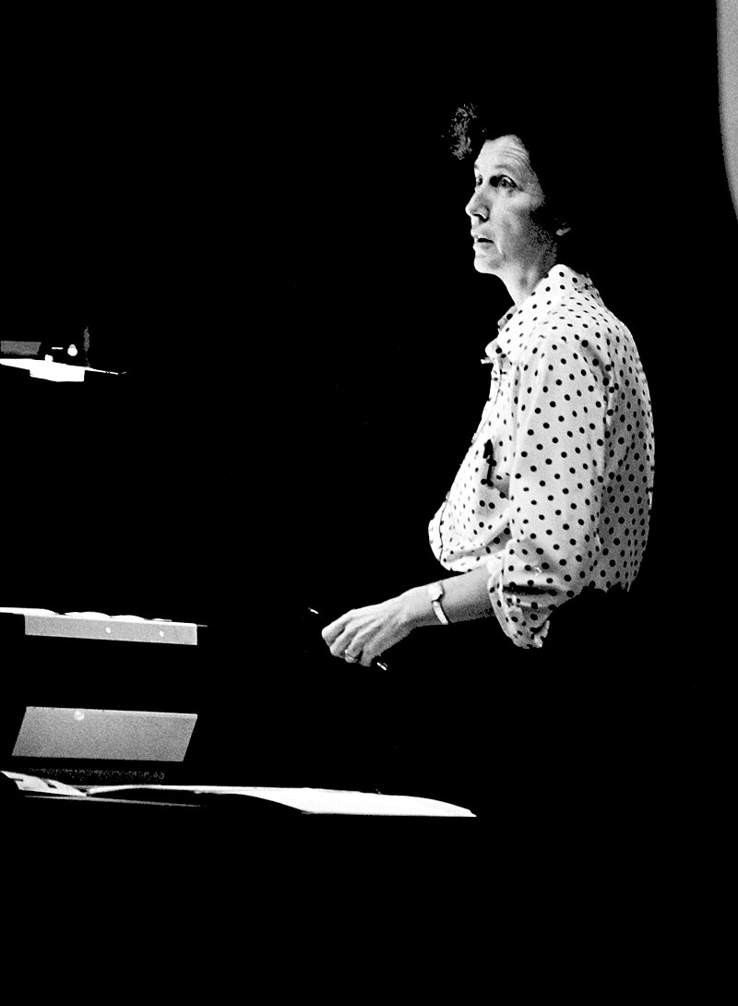
Helen T. Edwards
Tevatron, particle physics
By Fermi National Accelerator Laboratory - https://vms.fnal.gov/asset/detail?recid=1826402, Public Domain, https://commons.wikimedia.org/w/index.php?curid=78630893

Slide 34
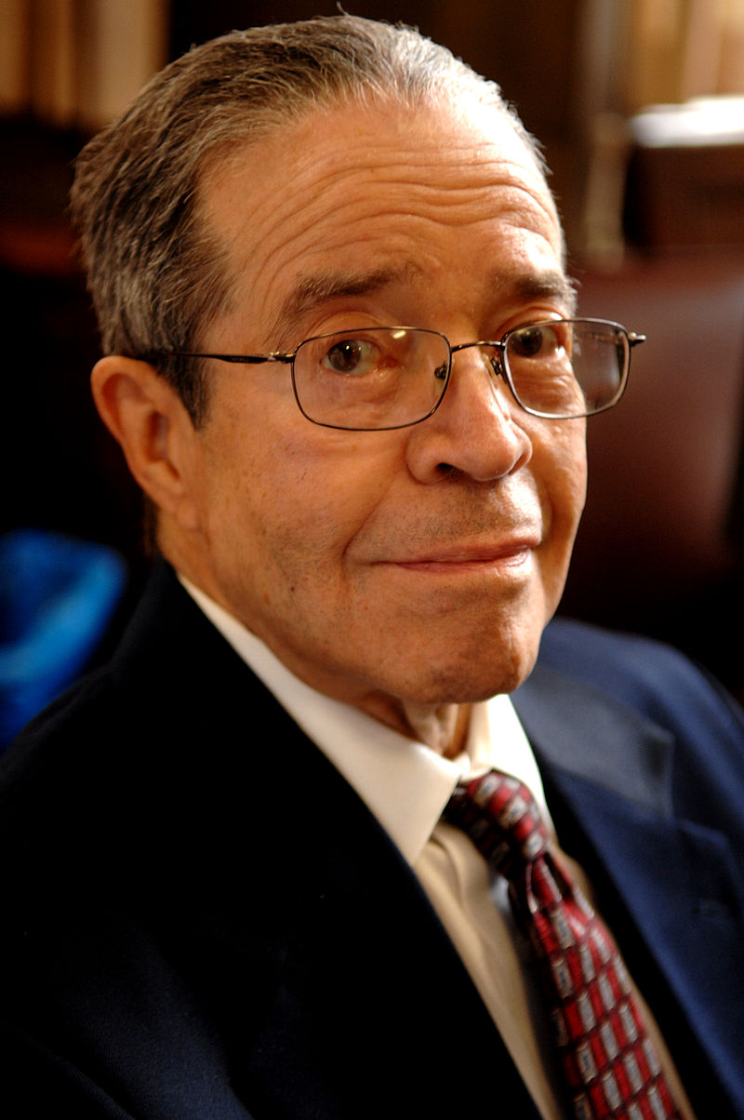
J. Ernest Wilkins Jr.
Nuclear physics
By Dan Dry, CC BY-SA 3.0, https://commons.wikimedia.org/w/index.php?curid=15457442

Slide 35
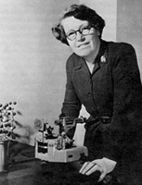
Helen Dick Megaw
crystallography
By Source, Fair use, https://en.wikipedia.org/w/index.php?curid=37385432

Slide 36
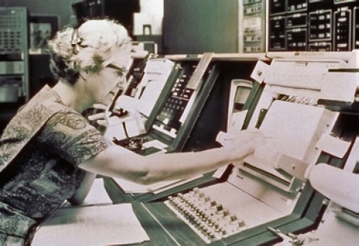
Nancy Roman
Hubble space telescope
By NASA - https://www.astrosociety.org/wp-content/uploads/2013/07/ab2013-112.pdf, Public Domain, https://commons.wikimedia.org/w/index.php?curid=64123626
https://www.youtube.com/watch?v=EjDZpUCNKMw

Slide 37
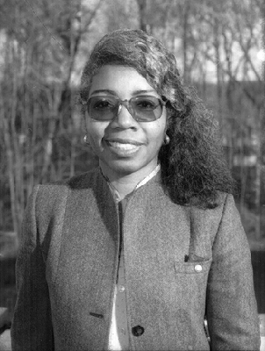
Valerie Thomas
Illusion transmitter
By NASA - http://nssdc.gsfc.nasa.gov/nssdc_news/sept95/04_j_green_0995.html, Public Domain, https://commons.wikimedia.org/w/index.php?curid=39603584
Video: https://www.youtube.com/watch?v=7VWHq_PsCaI

Slide 38
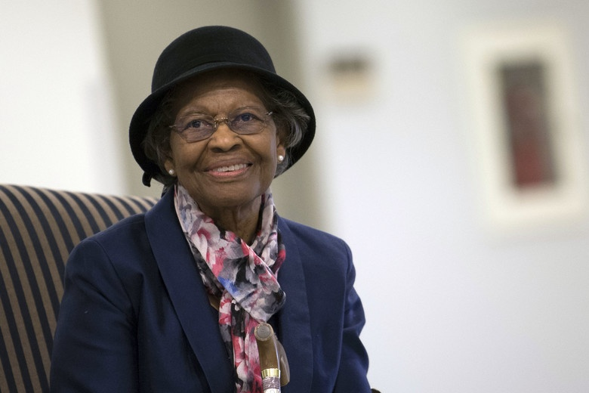
Gladys West
Satellite geodesy, GPS
By US Air Force - https://www.afspc.af.mil/News/Article-Display/Article/1707464/mathematician-inducted-into-space-and-missiles-pioneers-hall-of-fame/, Public Domain, https://commons.wikimedia.org/w/index.php?curid=75159845
https://www.youtube.com/watch?v=McIemoQWv64

Slide 39
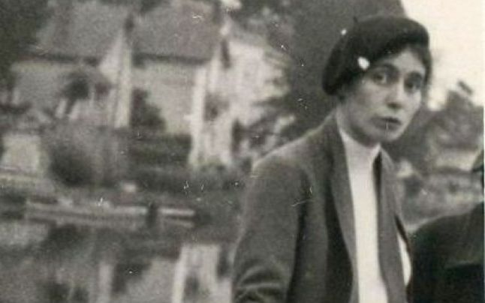
Yvette Cauchois
Synchrotron,
x-ray optics

Slide 40
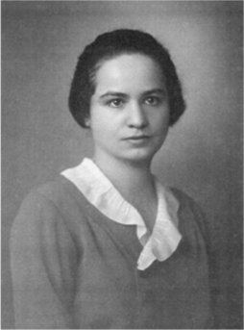
Marietta Blau
Cosmic ray detection
By Source, Fair use, https://en.wikipedia.org/w/index.php?curid=31802482

Slide 41
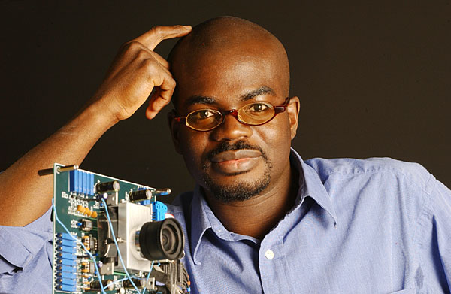
Kwabena Boahen
Computer bioengineer
Courtesy of University of Pennsylvania boahen. Kwabena Boahen
https://www.youtube.com/watch?v=mC7Q-ix_0Po

Slide 42
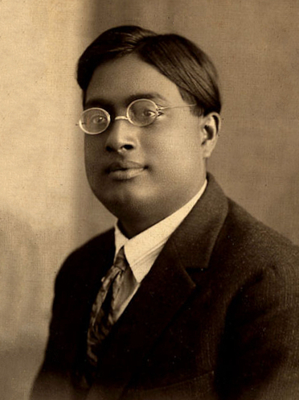
Satyendra Nath Bose
Theoretical particle physics, bosons
By Unknown - Picture in Siliconeer, Public Domain, https://commons.wikimedia.org/w/index.php?curid=2201891
https://www.youtube.com/watch?v=r2JVFWVQt-c

Slide 43
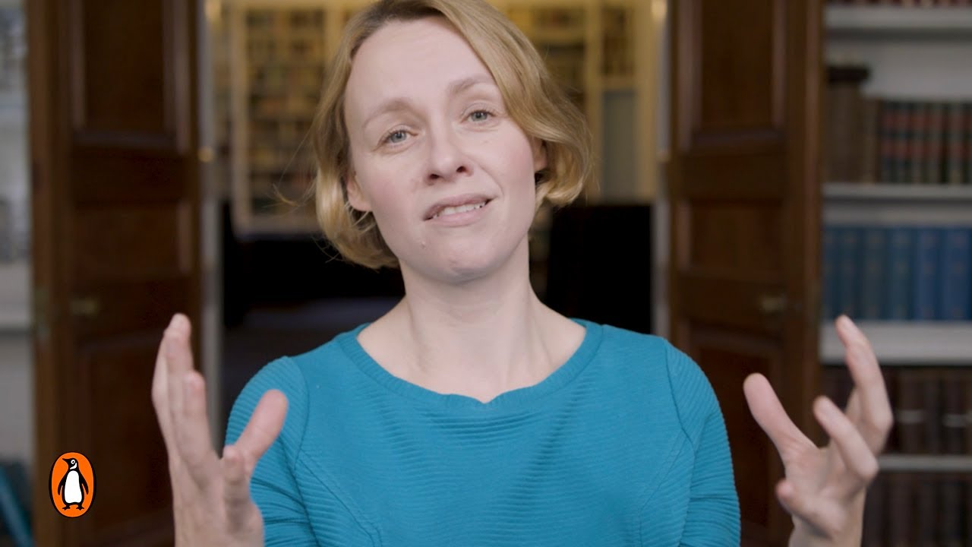
Jo Dunkley
cosmology

Slide 44
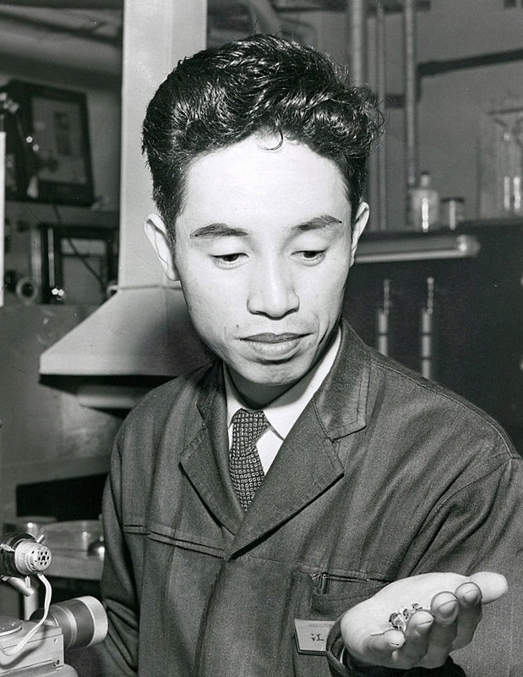
Leo Esaki
Electron tunneling in semiconductors
By Unknown (Asahi Shinbun) - http://www.gettyimages.co.uk/search/2/image?phrase=leo%20esaki%20asahi&family=editorial&sort=best&editorialproducts=&excludenudity=true&page=1, Public Domain, https://commons.wikimedia.org/w/index.php?curid=40844238

Slide 45
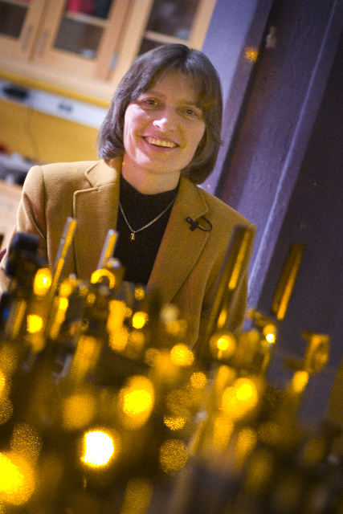
Lene Hau
Stopped light
By (Photo courtesy of Justin Ide/Harvard News Office) - http://www.wpafb.af.mil/news/story.asp?id=123133604, Public Domain, https://commons.wikimedia.org/w/index.php?curid=23881324
Video: https://www.youtube.com/watch?v=-8Nj2uTZc10

Slide 46
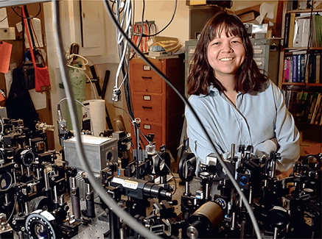
Deborah S. Jin
Bose-Einstein condensate
https://servicetoamericamedals.org/honorees/deborah-jin/

Slide 47
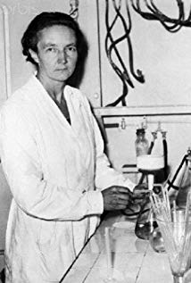
Irène Joliot-Curie
Artificial radioactivity
https://www.youtube.com/watch?v=xii_qBN0lcU

Slide 48
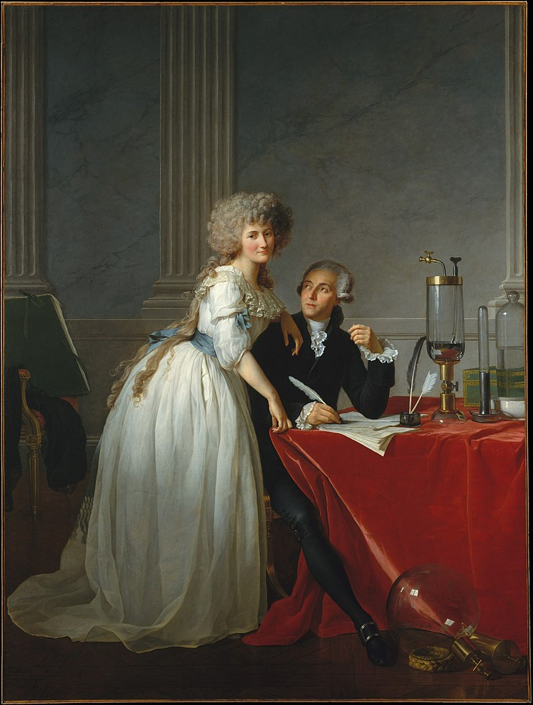
Marie-Anne Paulze Lavoisier
Chemical element identification
By Jacques-Louis David - Metropolitan Museum of Art, online database: entry 436106 (accession number: 1977.10), Public Domain, https://commons.wikimedia.org/w/index.php?curid=28550
https://www.youtube.com/watch?time_continue=1&v=EBEh1qZo7QU

Slide 49
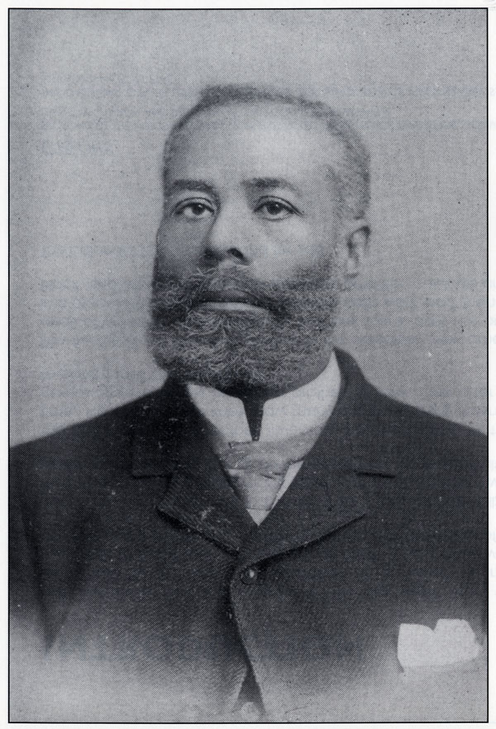
Elijah McCoy
Inventor, engineer
Image Source: Black inventors : 1998 calendar W. P. (Wilma Patricia) Holas. Ottawa : Pan-African Publications, c1998. Image Credit: Moorland-Spingarn Research Centre, Howard University
https://www.youtube.com/watch?v=RGnwC0gfD4g

Slide 50
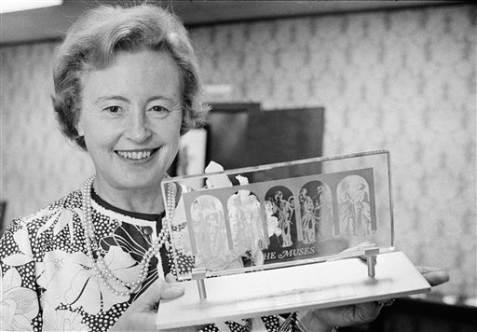
Margaret Burbidge
Stellar nuclear physics
By Annie Gracy - Own work, CC BY-SA 4.0, https://commons.wikimedia.org/w/index.php?curid=46506719
https://www.youtube.com/watch?v=Uu126S7iRBg

Slide 51
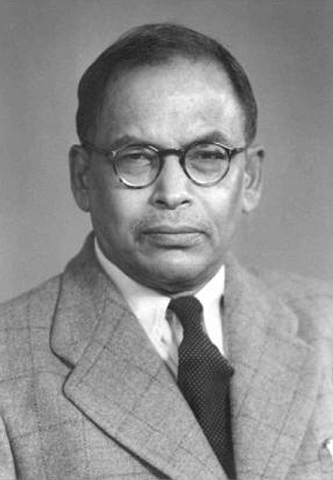
Meghnad Saha
astrophysicist
By Unknown - http://www.rkmstudentshome.org/our-inspirations/, Public Domain, https://commons.wikimedia.org/w/index.php?curid=39500054

Slide 52
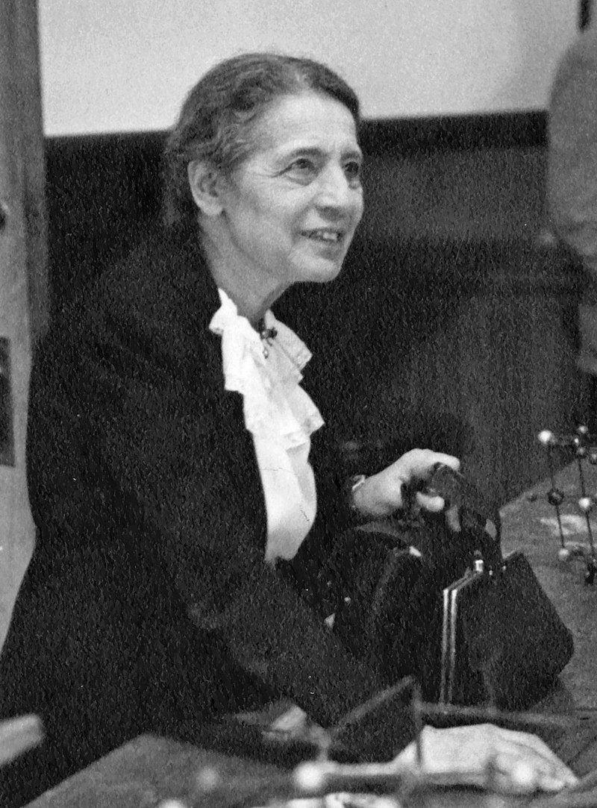
Lise Meitner
Nuclear physics, fission
By Smithsonian Institution - Flickr: Lise Meitner (1878-1968), lecturing at Catholic University, Washington, D.C., 1946, No restrictions, https://commons.wikimedia.org/w/index.php?curid=18386027
https://www.youtube.com/watch?v=uZZFG58G_jE

Slide 53
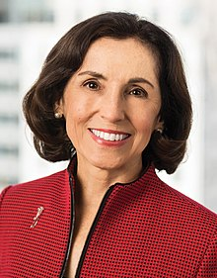
France Anne Córdova
astrophysicist
By National Science Foundation - https://www.nsf.gov/news/speeches/cordova/cordova_bio.jsp, Public Domain, https://commons.wikimedia.org/w/index.php?curid=61626982
https://vimeo.com/175548053

Slide 54
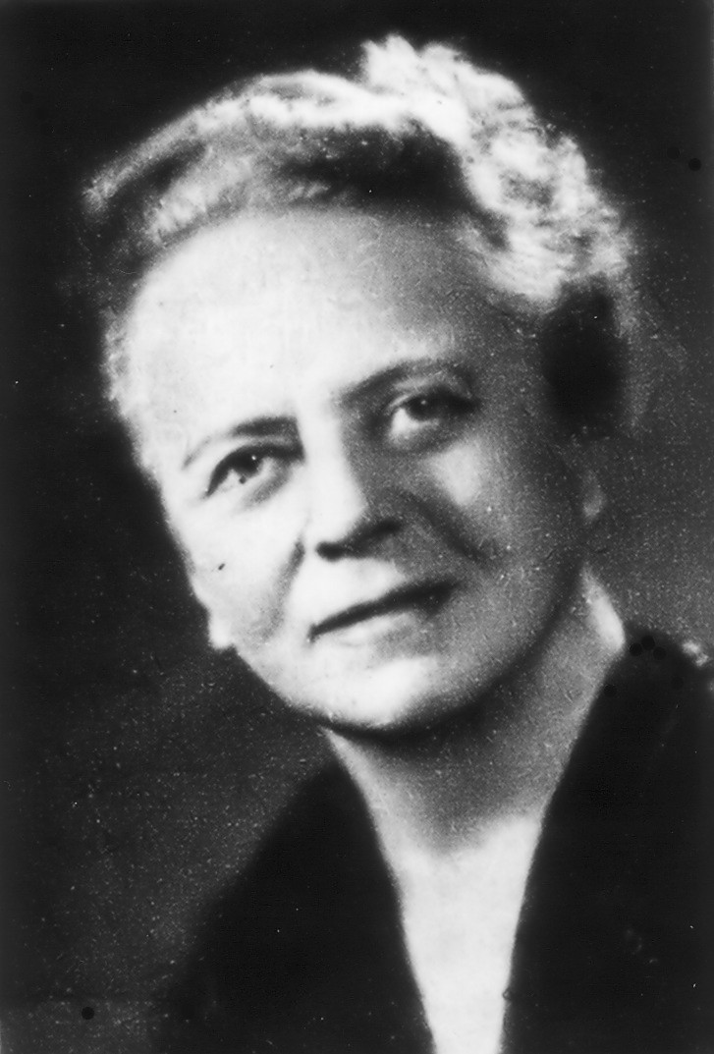
Ida Noddack
Nuclear physics, fission, rhenium
By Dome_de, CC BY-SA 3.0, https://commons.wikimedia.org/w/index.php?curid=1570016

Slide 55
Emmy Noether
Symmetry and conservation laws
By Unknown - Emmy Noether (1882-1935), Public Domain, https://commons.wikimedia.org/w/index.php?curid=66702
https://www.youtube.com/watch?v=Rqfj7n5aSwY

Slide 56
Payne-Gaposchkin Cecilia
Astrophysics, star composition
By Smithsonian Institution from United States - Cecilia Helena Payne Gaposchkin (1900-1979)Uploaded by Fæ, No restrictions, https://commons.wikimedia.org/w/index.php?curid=18877957
Video: https://www.youtube.com/watch?v=B2PUStoc09A

Slide 57
Abdus Salam
Theoretical physics, electroweak theory
By Molendijk, Bart / Anefo - [1] Dutch National Archives, The Hague, Fotocollectie Algemeen Nederlands Persbureau (ANeFo), 1945-1989, Nummer toegang 2.24.01.05 Bestanddeelnummer 933-9976, CC BY-SA 3.0 nl, https://commons.wikimedia.org/w/index.php?curid=31963525

Slide 58
Esther Conwell
Transistors, optic fibres, lasers
https://www.youtube.com/watch?time_continue=126&v=AtUZsj-AfBs

Slide 59
Samuel C. C. Ting
Particle physics
By Toastforbrekkie - Own work, CC BY-SA 3.0, https://commons.wikimedia.org/w/index.php?curid=14049578

Slide 60
Edith Anne Stoney
Medical physics
By Unknown photographer, archivist could not attribute it to a photographer(Life time: photograph pre-1894) - Original publication: not published, private photograph currently held in Newnham College archiveImmediate source: scan of the original photograph, Public Domain, https://commons.wikimedia.org/w/index.php?curid=64337881

Slide 61
Kathy Vivas
astrophysics
This work is licensed under the Government of Japan Standard Terms of Use (Ver.2.0). The Terms of Use are compatible with the Creative Commons Attribution License 4.0 International.

Slide 62
Wang Zhenyi
astronomer
https://www.youtube.com/watch?v=JMnbfSGO1x4
MATTEO FARINELLA

Slide 63
Sau Lan Wu
Particle physics
http://wisconsin.cern.ch/slw/

Slide 64
Hideki Yukawa
Particle physics, pi meson
By Nobel foundation - http://nobelprize.org/nobel_prizes/physics/laureates/1949/yukawa-bio.html, Public Domain, https://commons.wikimedia.org/w/index.php?curid=6182205

Slide 65
Rosalind Franklin
Crystallography, DNA
By Jewish Chronicle Archive/Heritage-Imageshttp://www.britannica.com/EBchecked/topic-art/217394/99712/Rosalind-Franklin, Fair use, https://en.wikipedia.org/w/index.php?curid=24959067
Video: https://www.youtube.com/watch?v=B2PUStoc09A

Slide 66
Juan Martín Maldacena
Quantum gravity
By Lumidek at English Wikipedia - Own work by the original uploader, CC BY 3.0, https://commons.wikimedia.org/w/index.php?curid=1033808

Slide 67
Hedy Lamarr
Inventor, frequency hopping
By Unknown - eBay, Public Domain, https://commons.wikimedia.org/w/index.php?curid=47176716
Video: https://vimeo.com/12017017

Slide 68
C. V. Raman
Light scattering
https://www.nobelprize.org/prizes/physics/1930/raman/biographical/

Slide 69
Mildred Dresselhaus
Carbon engineering
By Official White House Photo by Pete Souza - https://www.flickr.com/photos/whitehouse/7365530528/in/photostream, Public Domain, https://commons.wikimedia.org/w/index.php?curid=38819247/
https://www.youtube.com/watch?v=oPfh5nb09yY

Slide 70
Yang Chen-Ning
Particle physics
This file is licensed under the Creative Commons Attribution-Share Alike 3.0 Unported license.

Slide 71
John Dabiri
Biophysics, jellyfish propulsion
https://www.youtube.com/watch?v=3ebn6qyJAeY

Slide 72
Aprille Ericsson-Jackson
NASA engineer
By NASA/Goddard/Bill Hrybyk - NASA Goddard Space Flight Center via Flickr https://www.flickr.com/photos/nasa_goddard/24827529912/in/photolist-DPVzEy-CouoCJ-DbqwZJ-DiFLdQ-CTTdUw-bkaEYN-by5yCk-by5yye-bkaF3b-by5ysX-by5yjD-bkaEBU-by5yFB-FbQb41-CorSaU-Fkdfj7-FnvN4T-EUWAsd, CC BY 2.0, https://commons.wikimedia.org/w/index.php?curid=57030895
https://www.youtube.com/watch?v=DywbwPU7Zzw

Slide 73
Sophie Germain
Mathematician, physicist
https://www.youtube.com/watch?v=MWOruZtCDHw

Slide 74
James Andrew Harris
Nuclear physics, new elements

Slide 75
Juliet Lee-Franzini
Particle physics

Slide 76
Makoto Kobayashi
Particle physics
By Prolineserver (talk) - Own work, GFDL 1.2, https://commons.wikimedia.org/w/index.php?curid=5446488

Slide 77
Inge Lehmann
Geophysics, seismology
https://www.youtube.com/watch?v=w2Tj-8FJFeY

Slide 78
Leona Woods
Nuclear physics
By Argonne National Laboratory - Leona Woods Marshall Libby, Uranium People, pp. 182-183, Public Domain, https://commons.wikimedia.org/w/index.php?curid=25600002

Slide 79
Elsie MacGill
Aeronautical engineer
(courtesy Library and Archives Canada/Credit: Ashley and Crippen/Elsie Gregory MacGill collection/PA-148464
https://www.youtube.com/watch?v=WZoulEgf348

Slide 80
Ruby Payne-Scott
radiophysics
By Peter Gavin Hall (Ruby Payne-Scott's son) - Peter Hall (Ruby Payne-Scott's son), CC BY-SA 3.0, https://commons.wikimedia.org/w/index.php?curid=8185566

Slide 81
James B. Pollack
astrophysicist
By NASA/Ames Research Center - https://archive.org/details/AILS_AC92-0322-42, Public Domain, https://commons.wikimedia.org/w/index.php?curid=11604075

Slide 82
Shin'ichirō Tomonaga
Quantum electrodynamics
By Nobel foundation - http://nobelprize.org/nobel_prizes/physics/laureates/1965/tomonaga-bio.html, Public Domain, https://commons.wikimedia.org/w/index.php?curid=6138962

Slide 83
Daniel C. Tsui
Semi-conductors

Slide 84
Marie Van Brittan Brown
inventor
https://www.youtube.com/watch?v=0-F798nGoOg

Slide 85
James Edward Maceo West
Acoustician, inventor
By Sonavi Labs - Own work, CC BY-SA 4.0, https://commons.wikimedia.org/w/index.php?curid=76956715
https://www.youtube.com/watch?v=95EFhuRyAe0

Slide 86
Mary Katherine Gaillard
Particle physics

Slide 87
Chien-Shiung Wu
Particle physics
By Smithsonian Institution from United States - Chien-shiung Wu (1912-1997)Uploaded by Fæ, No restrictions, https://commons.wikimedia.org/w/index.php?curid=18877882
https://www.youtube.com/watch?v=P-VLIKS3oDI

Slide 88
Wendy Freedman
cosmology
By pollosaurio from Canada - Wendy Freedman, CC BY 2.0, https://commons.wikimedia.org/w/index.php?curid=50909535
https://www.youtube.com/watch?v=awcnVykOKZY

Slide 89
Albert Baez
X-ray microscope

Slide 90
Renata Kallosh
Quantum gravity

Slide 91
Melissa Franklin
Particle physics
http://spark.nautil.us/video/98/melissa-franklin

Slide 92
Corey Grey
Gravitational waves
Courtesy of Russell Barber
https://www.youtube.com/watch?v=s_6dPXqxPIA

Slide 93
Henry Cavendish
Mass of the Earth, hydrogen
By George Wilson - Frontispiece of The Life of the Hon. Henry Cavendish, Public Domain,
https://commons.wikimedia.org/w/index.php?curid=7373371
http://www.sixtysymbols.com/videos/cavendish.htm

Slide 94
Michael Faraday
electromagnetism
By Thomas Phillips - Thomas Phillips, 1842, Public Domain, https://commons.wikimedia.org/w/index.php?curid=463384
https://www.youtube.com/watch?v=dNXdF12U4wo

Slide 95
Ludwig Boltzmann
Statistical mechanics
By Unknown - Uni Frankfurt, Public Domain, https://commons.wikimedia.org/w/index.php?curid=865671

Slide 96
Gail Hanson
Particle physics

Slide 97
Nergis Mavalvala
Gravitational Waves
https://www.macfound.org/fellows/35/

